Slide 1
Energy Market Update
September 18, 2015
Chris Dubay
Energy Advisor

Slide 2
Market Dynamics
Power burn at record levels, mostly due to coal plant retirements
Production flat for most of 2015 so far at 71.5-73.5 Bcf/d, near-record levels despite falling rig counts
    Mexican exports at all-time highs, to double by 2018 as Mexico’s industrial demand grows, will add 7.1 Bcf/d of import capacity
    LNG exports may disappoint initially due to limited global demand
    Coal market collapsing

Slide 3
A Summer of Records . . .
Power burn: 38.6 Bcf/d on Jul. 29
Total U.S. dry production: 73.4 Bcf/d on Apr. 25
Northeast production: 20.4 Bcf on Aug. 24
    End-of-season storage level: >3.9 Tcf
    NYMEX NG calendar strip prices hit all-time lows on Aug. 25 (2017 - 2021) and Sep. 2 (2016)
    Mexican exports: 3.3 Bcf/d on Jul. 21

Slide 4
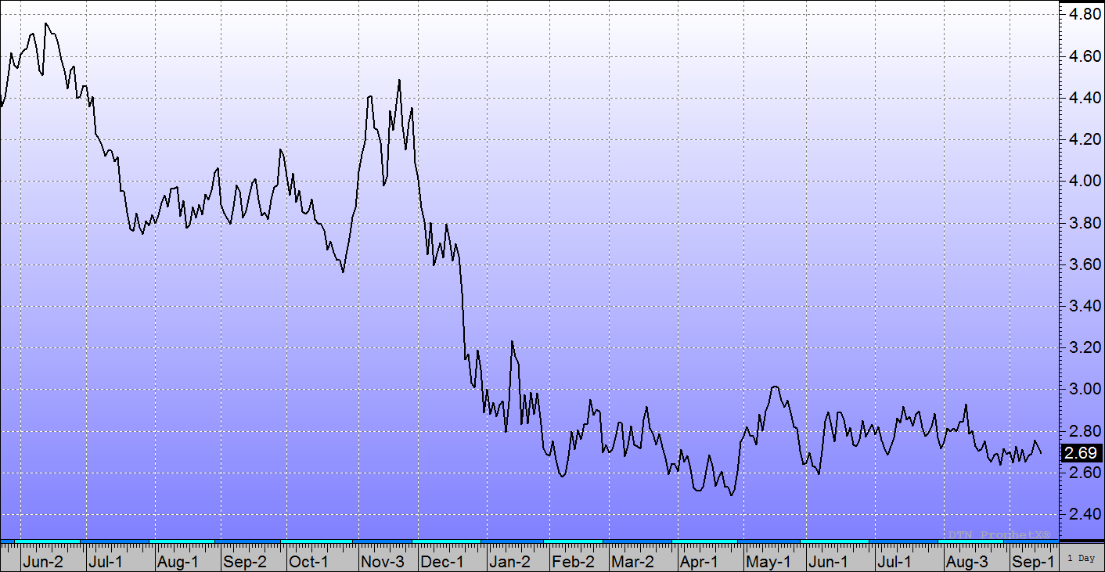
Robust Production and Healthy Storage Continue to Keep Downward Pressure on Prices
Polar Vortex: Reached 5-year highs in Feb ‘14
Weather forecasts turned dramatically colder . . .
. . . then warmer
Jul-Oct ‘14 range
$3.75 - $4.00
Jan-May range
$2.50 - $3.00
Much tighter Jun-Sep range
$2.65 - $2.90
Mild Dec, record production, minimal storage w/d
NYMEX Natural Gas Prompt Month Futures

Slide 5
NYMEX Gas at All-Time Lows
Upcoming winter and summer strips near record lows
2016 - 2018 calendar strip prices near all-time lows, present excellent value

Slide 6
Bearish Fundamentals
Decreasing demand as we move into shoulder season
  Mild, lower normal temperatures
  Temperature anomalies do not impact demand as much as in summer or winter
Production not increasing, but still near all-time high
Storage injection season expected to end at possibly highest level ever, currently in surplus to last year and 5YA

Slide 7
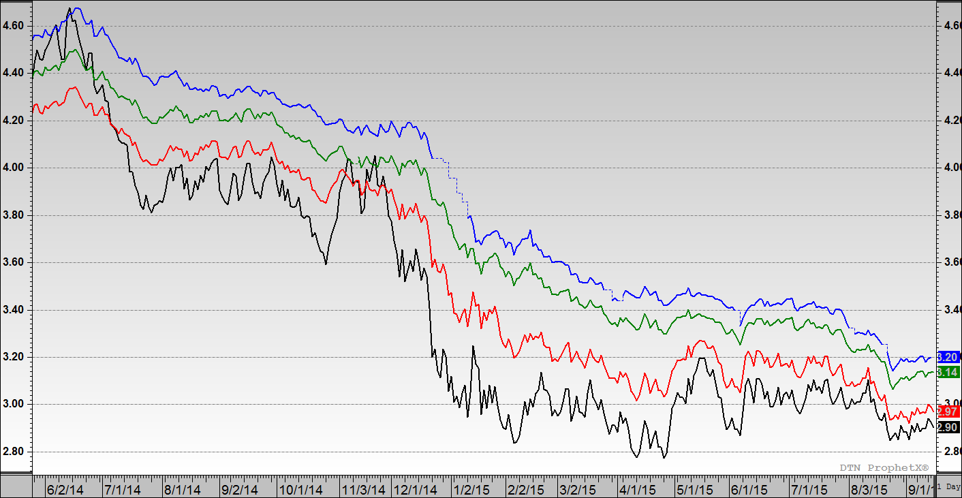
All Calendar Strips Near All-Time Lows!
All-Time Lows
Cal 16 $2.92 9/2/15
Cal 17 $3.07 8/25/15
Cal 18 $3.14 8/25/15
Cal 19 $3.21 8/25/15
Cal 20 $3.31 8/25/15
Cal 21 $3.45 8/25/15
12-mo Strip $2.90
NYMEX natural gas prices since June 2014

Slide 8
Dry Natural Gas Production Leveled Off in 2015
New all-time record:
73.4 Bcf/d on April 25th
+2.5 Bcf/d Y-o-Y
4% increase
However, exports to Mexico are at all-time high,
up 30% over last year!

Slide 9
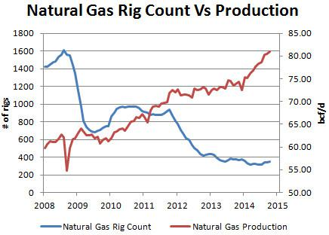
Dry Gas Production Continues Near Record High Despite Rig Counts at All-Time Low

Slide 10
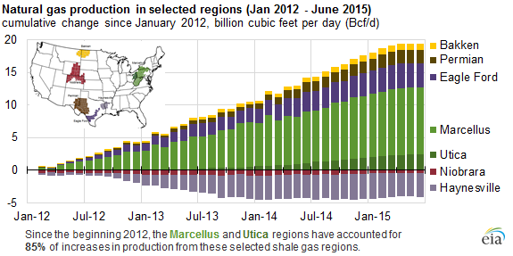
Marcellus, Utica Provide 85% of U.S. Shale Gas Production Growth since 2012
Increased efficiency: average new-well gas production per rig went from 3.2 MMcf/d in Jan ‘12 to 8.3 MMcf/d in Jul ’15, 159% increase!
U.S. shale basins now account for 56% of U.S. dry natural gas production

Slide 11
Surplus to 5YA Continues to Grow,
Surplus to Last Year Large, But Shrinking
End-of-season level ~ 3.9-4.0 Tcf

Slide 12
End-of-Season Storage Projection
22 out of the last 25 storage injections > five-year average (5YA)
Current weather forecasts indicate a strong finish to this year’s injection season
  Through 9/4, net storage injections totaled 1,800 Bcf, 155 Bcf less than last year, but 317 Bcf more than 5YA
  Storage building expected to continue into November
  EIA projects end-of-season (Oct. 31) levels = 3,840 Bcf
  Bentek Energy’s forecast for next three weeks: 73, 91, 89 Bcf

Slide 13
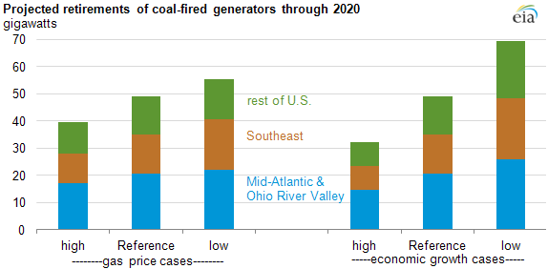
Long-Term Gas Bullish Factor: EPA Regulations
Two biggest reasons for coal plant retirements:
EPA’s Mercury and Air Toxic Standards (MATS) that began implementation in 2015
Low natural gas prices due to shale

Slide 14
U.S. Demand/Mexico/Canada/LNG/LPG Exports Support Future U.S. Production

Slide 15
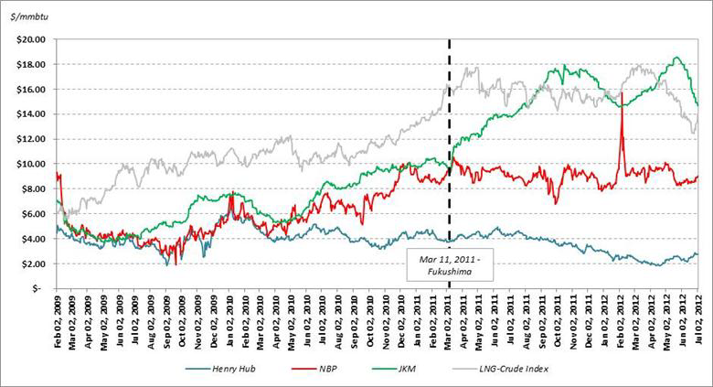
Long-Term Gas Bullish Factor: LNG Exports
U.S. is one of the lowest cost natural gas providers in the world
Four terminals have approval to export to non-FTA nations:
  Sabine Pass, LA (under construction)
  Lake Charles, LA
  Freeport, TX
  Cove Point, MD
6.37 Bcf/d

Slide 16
Low Coal Prices - For How Much Longer?
Market forces, not environmentalists – coal prices down 70% in last 4 years
Alpha Natural Resources, 4th largest coal producer , filed for bankruptcy last month
2 largest - Peabody Energy shares: $16 LY > $0.99; Arch Coal: $33 LY > $1

Slide 17
Shale Remains Dominant Market Factor
Balanced Bulls & Bears Limit Market Range
Near-Term
Long-Term
Weather risk
Drilling economics (supply)
Generation economics (demand)
Coal plant retirements due to EPA regulations
LNG exports
Growing industrial demand
Exports to Mexico
Bullish
Abundant shale
Record injection season
Reduced hurricane risk
Production near all-time high
Increased Canadian imports
Abundant shale
NG drilling efficiencies
End-user efficiency
Improved pipeline infrastructure
Bearish
Wildcards include weather, financial markets & speculators, U.S. and global economies, and geopolitical events
Repeat of 2008 highs or 2012 lows are unlikely
Long-term looks bullish compared to near-term
Notes:
- So where will prices go from here?
There are many market factors shown here, but shale gas continues to dominate and should keep prices at a relatively low price range when looking back at a long-term trend.
Bearish fundamentals of strong injections as well as strong shale production have driven prices lower
But prices are vulnerable to several bullish factors
Summer is not over
And hurricane season is just get busy, although the risk is less than a years ago as much US production have onshore with shale. But the threat to production in the Gulf of Mexico should not be ignored.
Even more important is the possibility that lower prices could stimulate increased coal-to-gas switching and production cuts – this is exactly what happened in summer of 2012 that pushed prices higher through the end of the year.
Falling imports from Canada and via LNG as well as growing exports to Mexico have also partially offset growing shale.
For long-term, shale gas via improved efficiency and significant reserves will limit any updated.
But the long-term is clearly more bullish due to EPA regulations that are shutting down coal plants in favor of gas and expected LNG exports as well as growing US manufacturing that are taking advantage of low domestic energy prices.
So the recent declines of long-term prices are a bit surprising since they were most driven by near-term weather despite some long-term bullish outlook - and they may therefore present a value.
Weather and financial markets are always wildcards that will surprise – the recent mild weather is a good example.
But overall, neither the highs of 2008 nor the lows of 2012 are likely to be repeated, so taking advantage of dips in-between makes sense.

Slide 18
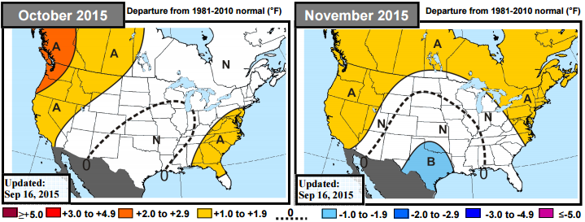
Extended Weather Outlook
October: warmer than normal West, northern Rockies, Southeast, and Mid-Atlantic – Ohio to be at normal temperatures
November: warm West and northern New England, cool Texas –
NE Ohio slightly warmer than normal

Slide 19
Preliminary Winter Outlook
Strong El Nino expected through winter
  1997-98 El Nino was strongest on record so far
  U.S. forecasters predict strongest since El Nino since record-keeping began in 1950
  Further warming in central Pacific Ocean in coming months
For Ohio, expect warmer-than-normal temperatures
  Slow start to winter
  Snow and ice should be less than normal
  Farmers’ Almanac: snowy and frigid!
  However, too many wildcards right now, too early
  Snowpack across Eurasia – favors early and late winter cold
  Early fall Arctic Sea ice increase – influences cold air mass traffic
  PDO (waters off West Coast) & NAO (North Atlantic Oscillation) changes between now and winter

Slide 20
AEP Wholesale Calendar Strip Power Prices

Slide 21
AEP Wholesale Power Price Analysis

Slide 22
AEP Around-the-Clock Wholesale Pricing
Summer 2016 near all-time low, winter still elevated
    Winter $47.70 on-peak $37.92 off-pk
    Summer $43.33 on-peak $27.30 off-pk
2017 - 2019 near all-time lows, present excellent value
2016 - 2019 prices backwardated

Slide 23
ATSI Wholesale Power Price Analysis

Slide 24
PJM ATSI Around-the-Clock
Wholesale Pricing – Similar to AEP
Summer 2016 near all-time low, winter still elevated
    Winter $50.48 on-peak $38.68 off-pk
    Summer $47.05 on-peak $27.82 off-pk
2017 - 2019 near all-time lows, present excellent value
2016 - 2019 prices backwardated

Slide 25
Questions?

