Slide 1

Steve Baum
Compass Energy

Slide 2
Compass Energy
Gas Prices – where are we headed?
CNG Vehicles

Slide 3
Parent Company – AGL Resources, Inc
Stock Ticker - “GAS”
$9.0 Billion in assets
7 Regulated Utilities
  4.5 million customers
  139,000 miles of pipe
  31 Bcf of storage
  5 LNG facilities
3 Unregulated Companies
  Sequent – Wholesale (Houston)
  Compass Energy – C&I
  Southstar – Residential & Small Commercial

Slide 4
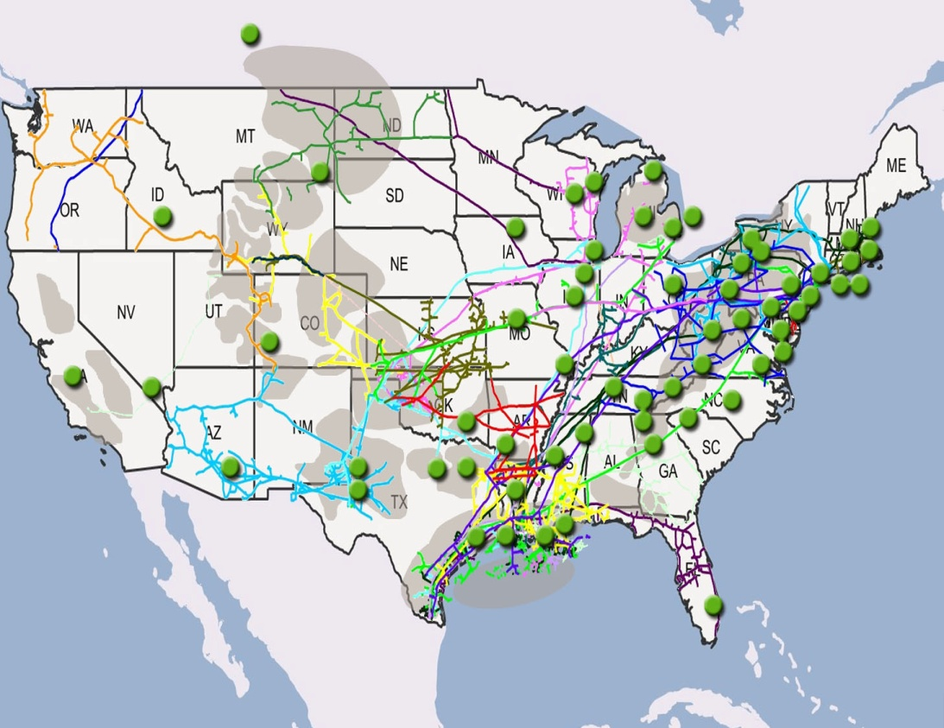
Sequent

Slide 5
Southstar & Enerchange
Lisa Dyer
Cincinnati

Slide 6
The price of Natural Gas

Slide 7
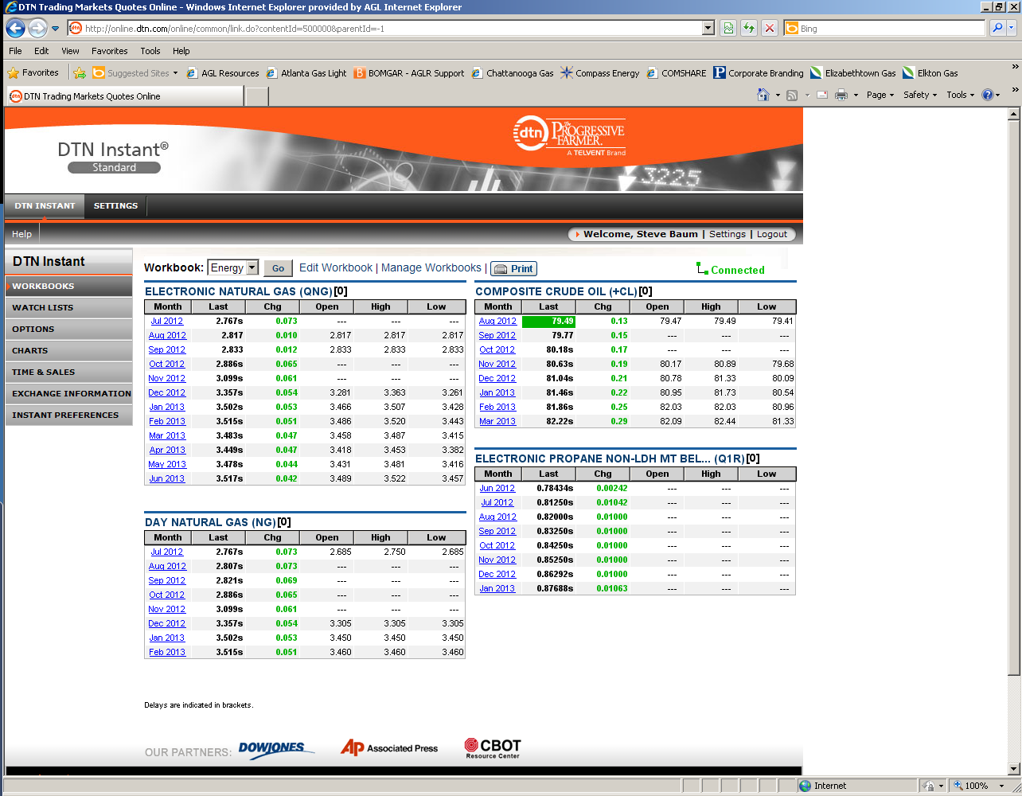

Slide 9

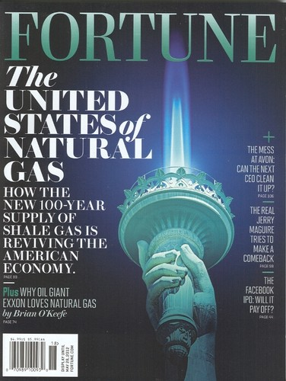

Slide 10
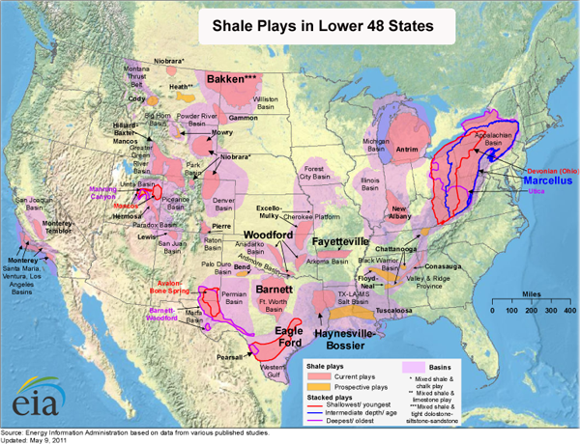

Slide 11
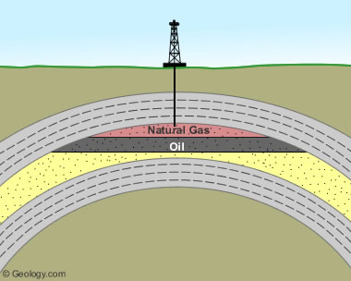

Slide 12
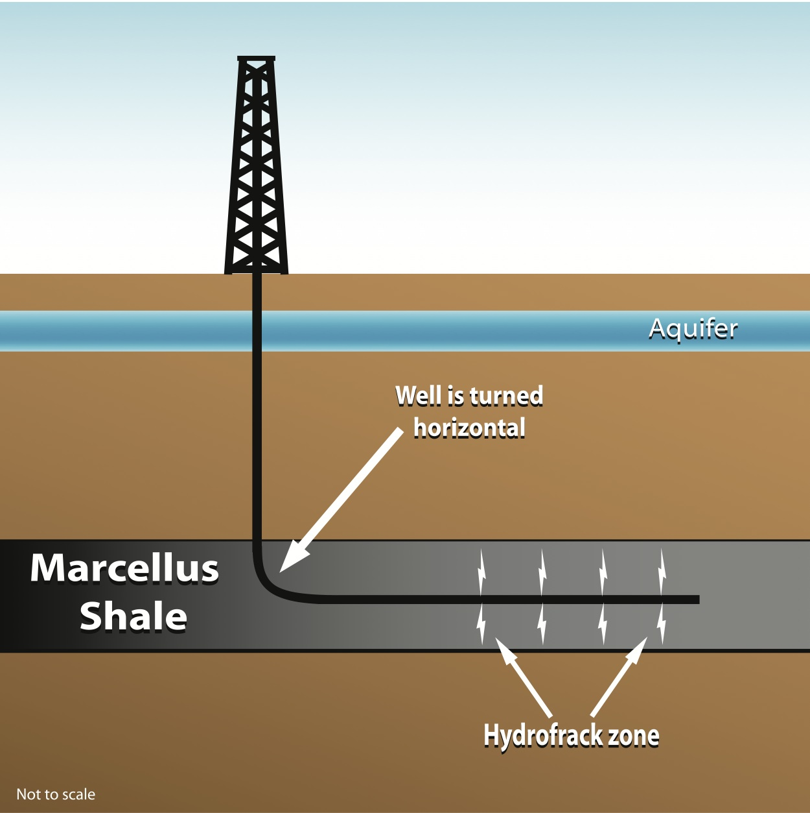

Slide 13
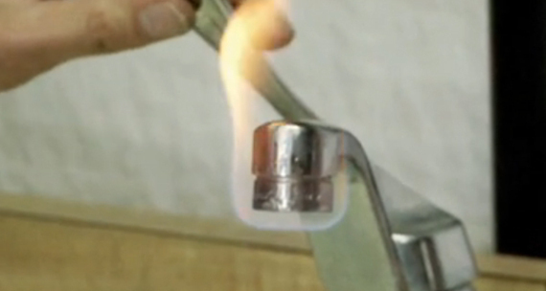

Slide 15
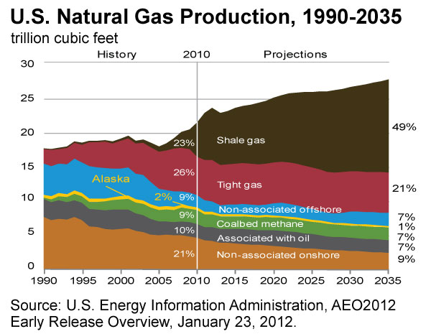

Slide 16
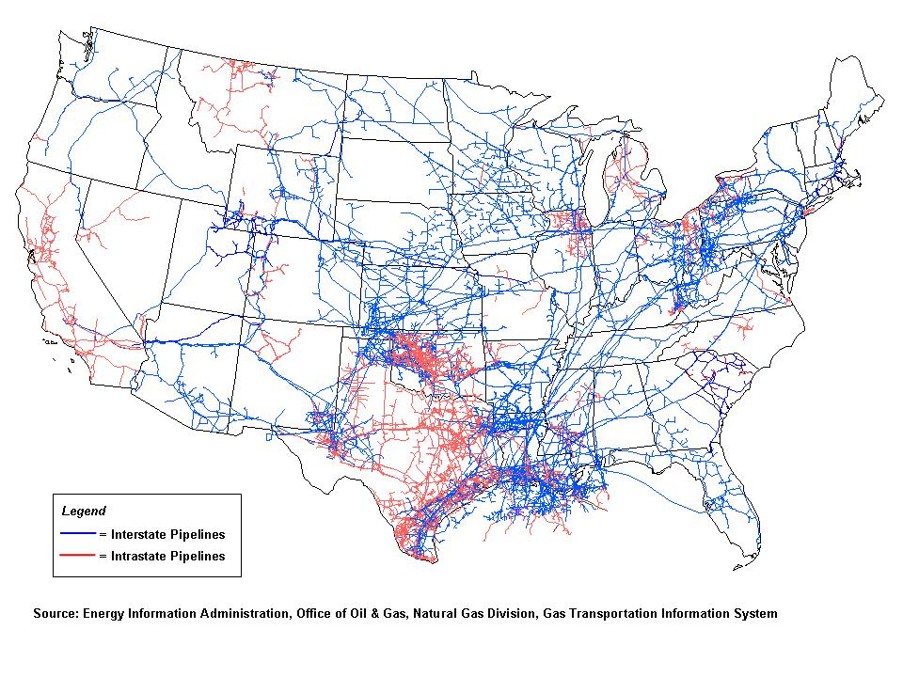

Slide 18
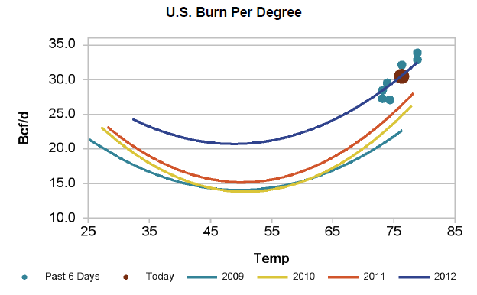

Slide 19
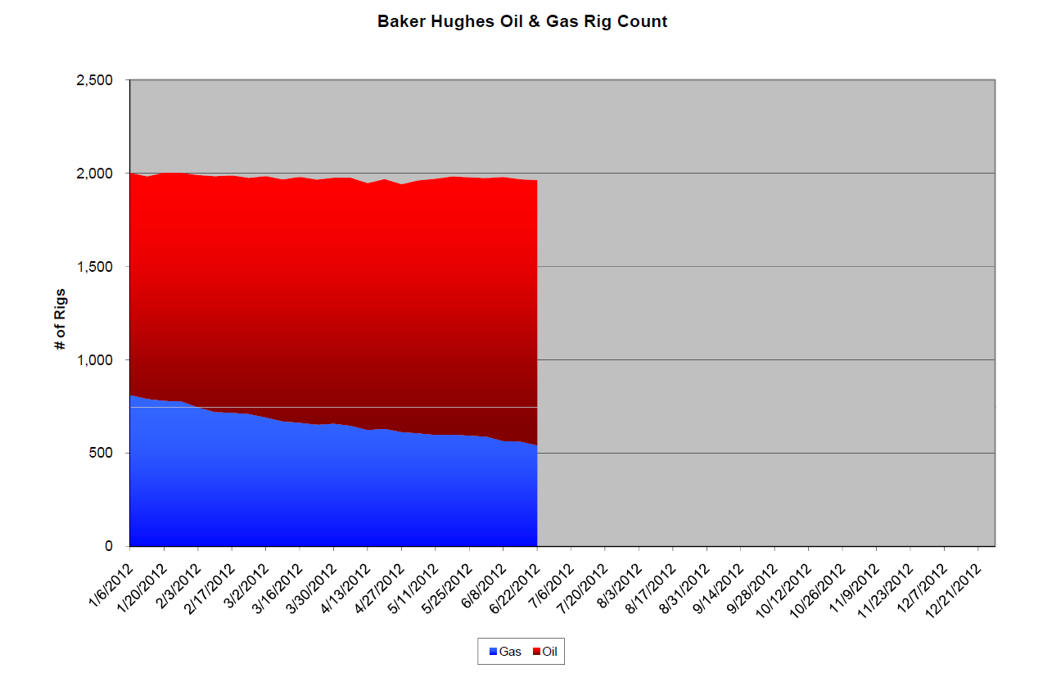

Slide 20


Where are Prices Going?
Warmest winter on record
Large shale supplies continue to flood the market
Weak Economy
Strong Gas Fired Power Market
Rig Count Going Down
Wells being shut in

Slide 23
Gas Prices are at 20 year lows
Don’t be a hero
Take advantage of these prices now
Never go into a winter unhedged
September - $2.75

Slide 24
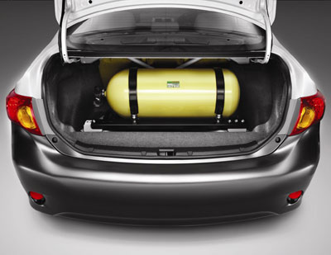
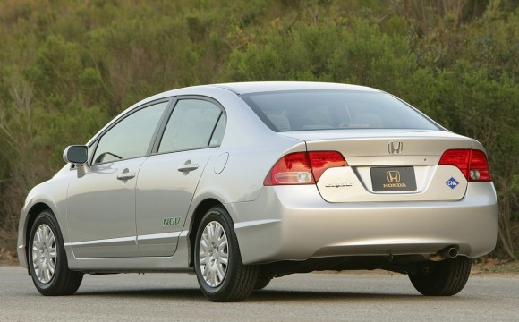
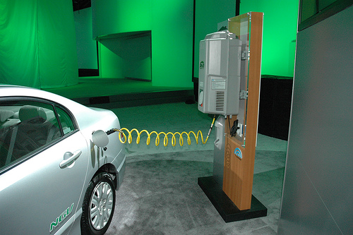


Slide 25
Emissions Reduction in Real Numbers
Reduces carbon dioxide (CO2) emissions by 20%-30%
Reduces carbon monoxide (CO) emissions by 70%-90%
Reduces nitrogen oxide (NOx) emissions by 75%-95%
Reduction of up to 90% of particle matter (PM) emissions
Reduces volatile organic compound (VOCs) emissions by 89%
Source: NGVAmerica/DOE/EPA

