Slide 1
The EPA’s Redesigned Redesign of Our Electricity System
Association of Energy Engineers
Cincinnati, Ohio
September 18, 2015
Heath Knakmuhs
Senior Director for Policy
Institute for 21st Century Energy
U.S. Chamber of Commerce

Slide 2
What is… Recently Finalized Rules Impacting Energy
316(b) Cooling Water Intake
Sulfur Dioxide NAAQS
PM 2.5 NAAQS
Regional Haze
Cross State Air Pollution Rule (CSAPR)
Utility MACT (MATS)
Coal Combustion Residuals

Slide 3
More of What is… Even More Recently Finalized Rules Impacting Energy
“Waters of the U.S.” (issued May 27, 2015)
CO2 Regulations for New (and modified) Power Plants (NSPS)
CO2 Regulations for Existing Power Plants (ESPS)

Slide 4
…And What Should Never Be Major Pending Rules
Effluent limitation Guidelines (final due September 2015 )
Ozone (final due October 2015 )
White House NEPA Guidance (released December 2014 )
Stream Buffer Zone (April 2015; comments due October 26 )

Slide 5
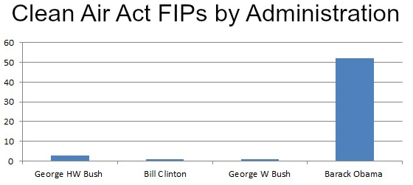
Decline of Cooperative Federalism
Clean Air Act: “air pollution prevention…at its source is the primary responsibility of States and local governments.”
EPA has promulgated a record 54 Federal Implementation Plans during the Obama Administration.
Source: Competitive Enterprise Institute

Slide 6
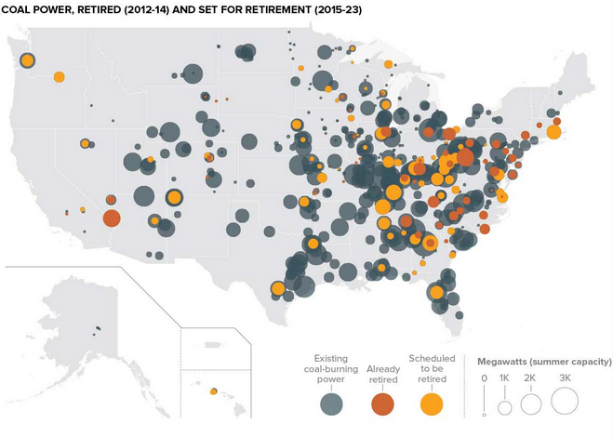
Closures in Context
Plant Closures from Finalized Rules
>50 GW prematurely retired by 2020
Source: Politico

Slide 7
The Fallout from Utility MACT Alone

Slide 8
Clean Air Act Section 111(d)
111(d) Standards of performance for existing sources; remaining useful life of source
(1) The Administrator shall prescribe regulations which shall establish a procedure similar to that provided by section 7410 of this title under which each State shall submit to the Administrator a plan which (A) establishes standards of performance for any existing source for any air pollutant (i) for which air quality criteria have not been issued or which is not included on a list published under section 7408(a) of this title or emitted from a source category which is regulated under section 7412 of this title but (ii) to which a standard of performance under this section would apply if such existing source were a new source, and (B) provides for the implementation and enforcement of such standards of performance. Regulations of the Administrator under this paragraph shall permit the State in applying a standard of performance to any particular source under a plan submitted under this paragraph to take into consideration, among other factors, the remaining useful life of the existing source to which such standard applies.
(2) The Administrator shall have the same authority—
(A) to prescribe a plan for a State in cases where the State fails to submit a satisfactory plan as he would have under section 7410(c) of this title in the case of failure to submit an implementation plan, and
(B) to enforce the provisions of such plan in cases where the State fails to enforce them as he would have under sections 7413 and 7414 of this title with respect to an implementation plan.
In promulgating a standard of performance under a plan prescribed under this paragraph, the Administrator shall take into consideration, among other factors, remaining useful lives of the sources in the category of sources to which such standard applies.

Slide 9
EPA’s “Clean Power Plan”
3000+ pages from less than 300 words
1 word = 100+ pages

Slide 10
CO₂ Rules for Existing Power Plants
Proposed June 2, 2014 / Finalized August 3, 2015
Final increases overall stringency to require national carbon emissions reductions of 32% below 2005 levels by 2030
Delayed 2022 compliance with incentives for early action
Clean Energy Incentive Program (renewables/low-income)
Focus on reducing use of all fossil fuels
4% reduction in NGCC versus BAU
Revision and reshuffling of the EPA’s “Building Blocks”
FIP and emissions trading

Slide 11
CO₂ Rules for Existing Power Plants
Sets specific performance rates (BSER)
1,305 lb CO²/MWh for fossil fuel steam
771 lb CO²/MWh for NGCC
Apply above to a state’s 2012 generation mix
Timeline
October 2015 (???): Federal Register Publication
September 6, 2016: Initial SIP with extension or final SIP
September 6, 2017: Progress report due with commitment to plan architecture
Single or multi-state; rate-based or mass-based; draft legislation/regulations
September 6, 2018: Final plans due
January 2020: CEIP Begins
2022-2030: Initial, Interim, and final compliance years

Slide 12
CO₂ Rules for Existing Power Plants
Rebuilt “Building Blocks”
BB1: 4.3% - 2.1% Heat Rate Improvements at all coal-fired power plants.
Proposed 6% Heat Rate Improvements across the board
BB3(a): Effective 28% National RPS / 25% greater than proposal
Proposed rule set regional targets based on state RPS goals (22% total)
BB3(b) “at risk” nuclear removed as BSER; new used for compliance.
BB2: 75% summer capacity factor for NGCC existing/under construction
Proposed 70% capacity factor by 2020 / final ramps up by 2030
BB4: Eliminated -- No longer part of BSER / Huge compliance role
Proposed year-over-year 1.5% reductions
Fence Line

Slide 13
Revised, Unequal Rate-Based Goals
Ohio
35.8% reduction
- 665 lbs CO²/MWh

Slide 14
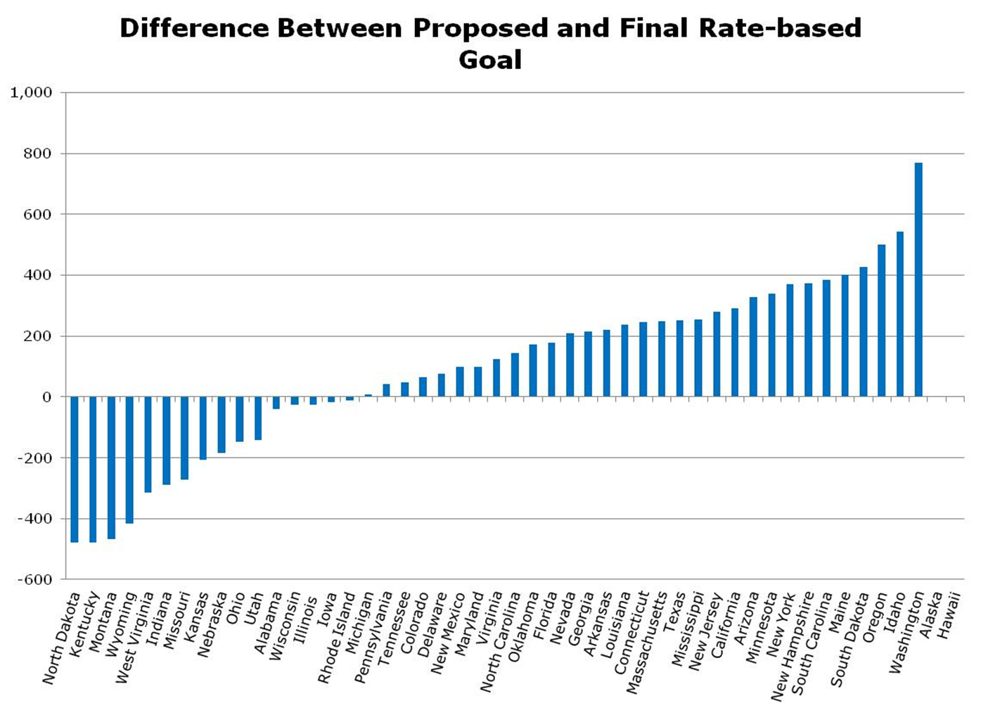
LOTS of Changes
Ohio
Proposed: 27.7% reduction
Final: 35.8% reduction
Sources: NERA Economic Consulting summary of American Council for an Energy Efficient Economy data
13

Slide 15
State Burdens Vary Widely

Slide 16
Not Cap and Trade
“This is not a cap and trade program”

Slide 17
Federal Implementation Plan (FIP)
Released with Final Rule on August 3, 2015
Two approaches to a federal plan:
“a rate-based emission trading program”
OR
“a mass-based emission trading program”
If not cap and trade, what is it???

Slide 18
The Winners … and the Losers

Slide 19
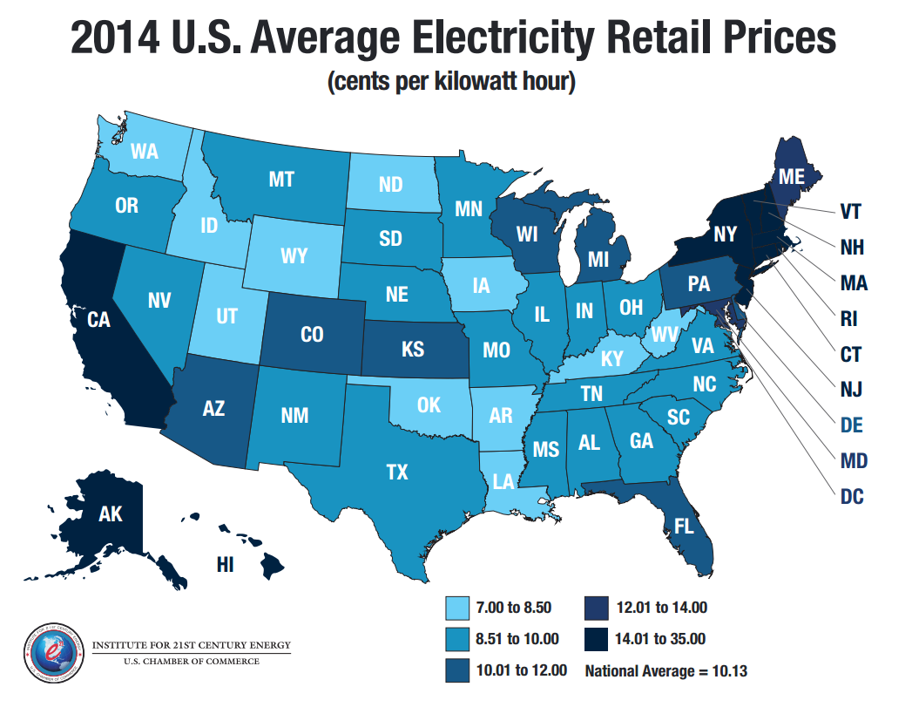
Turning State Losers into Federal Winners

Slide 20
New Source Performance Standard
Also finalized on August 3, 2015
New Coal: 1,400 lbs CO²/MWh
New NGCC: 1,000 lbs CO²/MWh
New coal must implement 16-23% CCS
Commercial availability?
ESPS reminder:
Existing coal: 1,305 lbs CO²/MWh
Existing NGCC: 771 lbs CO²/MWh

Slide 21
NSPS versus ESPS
EPA Expects this…
to outperform and be more efficient than…

Slide 22
NSPS versus ESPS
This…
Arbitrary and capricious???

Slide 23
EPA’s Fuzzy Math
EIA projection on coal (2015-16)
291GW to 269GW (22GW decrease)
EPA’s new projection in final rule (2015-16)
78 GW DECREASE (all without CPP!)
Proposed rule coal generation in 2030
1.67 terawatt hours
Final rule coal generation in 2030
1.47 terawatt hours (12% reduction from base case)

Slide 24
EPA’s Fuzzy Math
EPA replaced 90% of 200 billion watt hours of “missing” coal output with non-hydro renewables
EPA’s new base case includes 30% more renewable generation than in proposal
In proposal:
20% of emissions reduction would occur by 2030
In final rule:
A whopping 50% of reductions occur in base case
EPA’s 7-page fact sheet omits any mention of changes

Slide 25
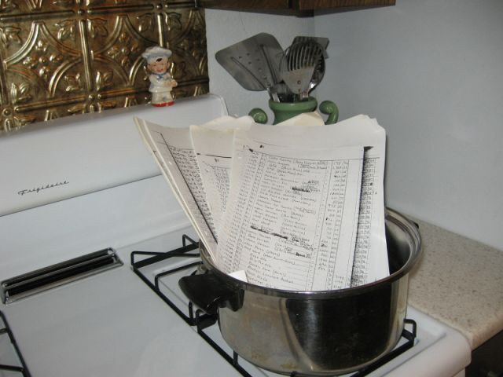
Economic Impacts
Thus, the EPA has…

Slide 26
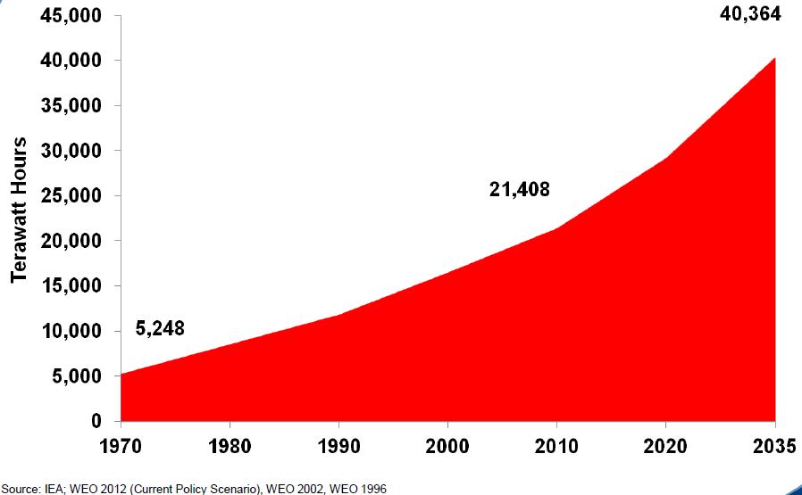
Global Perspective
Electricity demand to increase 670% in just two generations
Chart courtesy of Dr. Frank Clemente, Penn State Univ.

Slide 27
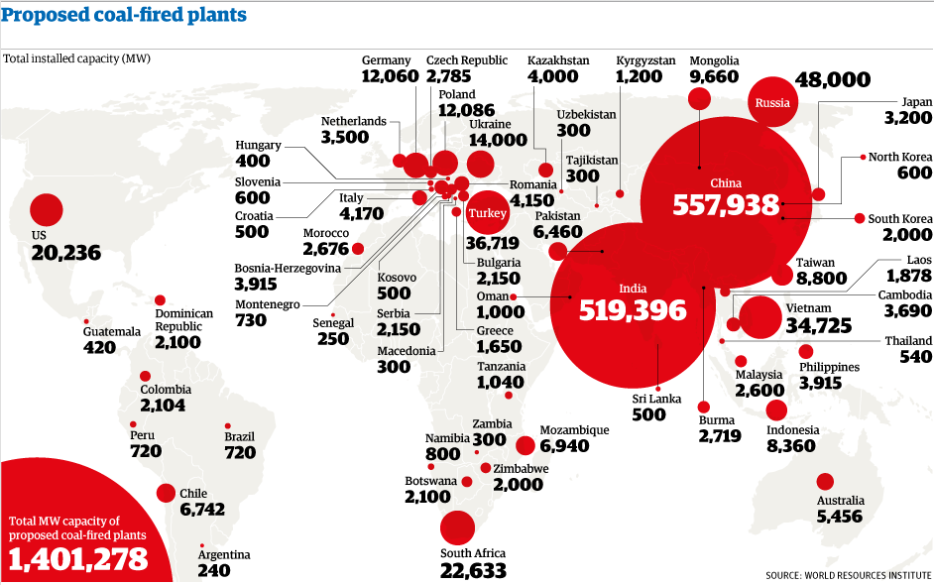
Global Perspective
Rest of World Aggressively Building New Coal Plants
Data source: World Resources Institute; Image developed by Tim Channon (2012)

Slide 28
Global Context
Non-U.S. CO₂ emissions are projected to increase 55 percent between 2010 and 2040.
In 2030, the reductions from EPA’s rule would offset the equivalent of just 14 days of CO2 emissions from China.
The cumulative emissions reductions from EPA rule (2020-30) will merely offset 100 days of Chinese emissions in 2030. (per IEA WEO)
Because U.S. businesses compete on a global scale, the electricity and related price increases resulting from EPA’s rule will severely disadvantage energy intensive, trade-exposed industries such as chemicals, manufacturing, steel, and pulp and paper. Such circumstances would not actually serve to reduce carbon emissions, but instead simply move them to other countries that have not implemented similar restrictions.

Slide 29
All Pain For Essentially No Gain

Slide 30
But Don’t We Have a ‘Deal’???
November 11, 2014 announcement
U.S. will decrease emissions 26-28 percent below 2005 levels by 2025.
China “targets to peak CO2 emissions around 2030.”
Lawrence Berkeley National Laboratory (2011)
China expected to plateau its carbon emissions around 2030 because of a projected slowdown in urbanization, population growth and heavy industry.

Slide 31
It Doesn’t Look Like One
Source: New York Times

Slide 32
Key State Considerations
Analysis of ratepayer, economic, and reliability impacts needed
Carbon leakage (and job leakage) to neighboring states and overseas
Timing, Potential Changes from Lawsuits, 2016 Election
SIP vs. FIP
SIPs Become Federally Enforceable
STILL no evidence that a FIP would be worse than a SIP
NO reason to rush into a State Implementation Plan

Slide 33
Skeptical Legality…
Supreme Court in UARG v. EPA (2014):
“When an agency claims to discover in a long extant statute an unheralded power to regulate a significant portion of the American economy…we typically greet its announcement with a measure of skepticism.”

Slide 34
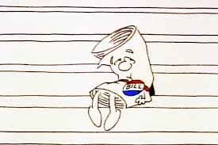
…of Born-Again Legislation.
Federal RPS CEIP + 28%
Environmental Justice Low-Income 2x Credit
Cap and Trade FIP

Slide 35
Time to Learn More and TAKE ACTION
Join us and help secure
America’s Energy Future
WWW.ENERGYXXI.ORG
Institute for 21st Century Energy
@Energy21

