Slide 1
Electric Security Plan Update – June 27, 2014
Jim Ziolkowski, Director, Rates and Regulatory Planning

Slide 2
Agenda
Overview of ESP Application
SSO Supply and Pricing
Provisions Relating to Distribution Service
Provisions Relating to Stability and Certainty
Auction Schedule and Rider Tables
Price To Compare

Slide 3
Overview
Duke Energy Ohio proposes an Electric Security Plan for a term of three years that:
Continues the current auction process for procuring supply for non-shopping load;
Addresses rate design issues for Riders RC and RE;
Includes provisions for distribution service;
Proposes a rider mechanism that will function as a partial hedge against wholesale price volatility; and
Does not include non-market based generation riders or arrangements.
Hearing scheduled for September 8, 2014.
Notes:
Process to convert auction prices to retail prices is similar but changes allocation of capacity to 5 CP

Slide 4
SSO Supply
Auction follows same format as in current ESP (i.e., descending clock).
Delivery periods and auctions staggered.
At least two auctions for each delivery period.
Charles River & Associates to manage auction process.
Excludes procurement of RECs to comply with renewable energy standards.
Full-requirements, load following for 100% of SSO or non-shopping load.
Continuation of Supplier Cost Reconciliation Rider (Rider SCR) to true-up SSO revenue with SSO supply costs.
Rider SCR includes recovery of auction-related costs from SSO customers.

Slide 5
SSO Pricing
Modify rate design on “revenue neutral” basis.
Simplify SSO rates and modify to more closely resemble market rates.
Eliminate demand charges for generation under all rate schedules so that all SSO generation rates are “energy-based,” mirroring what competitive retail electric suppliers typically offer shopping customers.
No demand ratchets for Duke Energy Ohio’s generation-related charges.
Reduce the block price differences in residential tariffs (RS, RSLI, RS3P, ORH, CUR).

Slide 6
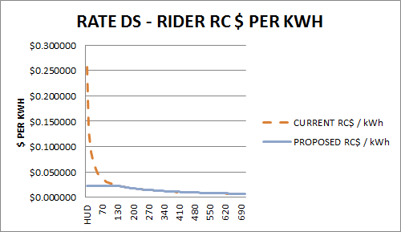
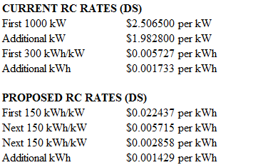
SSO Pricing - Eliminate Rider RC Demand Charges (Rate DS)

Slide 7
Distribution Service
Distribution Capital Investment Rider (Rider DCI)
Rider DCI would provide for recovery of the incremental revenue requirement associated with the return on, depreciation expense, and property taxes for incremental rate base over amounts in current base rates.
Quarterly update filings and subject to annual audit by PUCO Staff.
Modeled after similar riders approved for the FirstEnergy operating companies and for AEP Ohio.
Rider DCI would not recover any costs associated with Grid Modernization as long as such costs are being recovered in a separate rider.
Distribution Storm Recovery Rider (Rider DSR)
Tracks storm costs above/below baseline amount from rate case.
Rider recovery begins if regulatory asset exceeds $5 million; otherwise, amortize positive/negative balance of deferral in next rate case.

Slide 8
Provisions Relating to Stability and Certainty
Price Stabilization Rider (Rider PSR)
Financial arrangement to flow through gains/losses on power delivered from OVEC to Duke Energy Ohio.
Arrangement would be financial only as there would be no physical flow of power from OVEC to Duke Energy Ohio’s retail customers.
Acts as a partial hedge against market volatility.
Does not displace SSO supply or adversely affect CRES providers’ ability to attract customers.
Quarterly filings with true-ups.
Charge is non-bypassable.

Slide 9
Electric Security Plan Rate Structure
Current
Proposed
RC and RE
Retail Capacity and Energy
Derived from auction
RC and RE
Retail Capacity and Energy
Derived from auction
SCR
Supplier Cost Reconciliation
SCR
Supplier Cost Reconciliation
AERR (RECs)
Alternative Energy Recovery
AERR (RECs)
Alternative Energy Recovery
Rider RTO
Various RTO costs
Rider RTO
Various RTO costs
BTR
Base transmission incl. NITS
BTR
Base transmission incl. NITS
ESSC
Electric Security Stabilization
PSR
Price Stabilization Rider
UE-GEN
Generation Uncollectibles
UE-GEN
Generation Uncollectibles
LFA
Load Factor Adjustment
Legend
DCI
Distribution Capital Investmt
Fully Bypassable
Distribution rates and riders
Non-Bypassable
DSR
Distribution Storm Rider
Other Distribution rates and riders
9

Slide 10
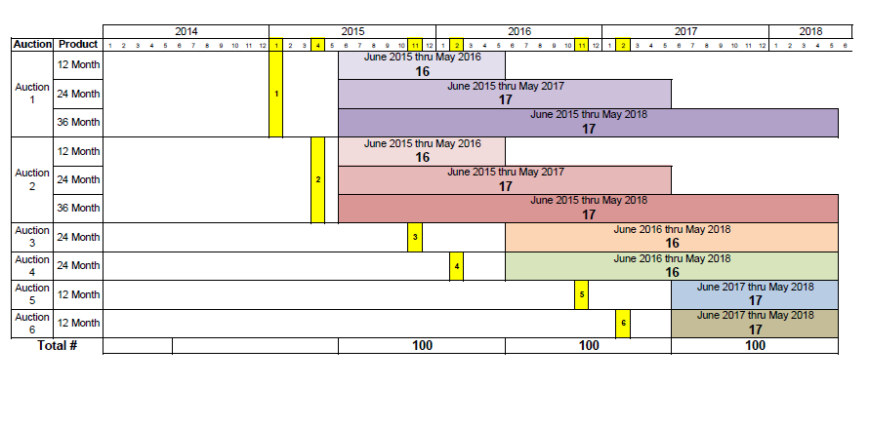
Auction Schedule

Slide 11
New Riders
Table 1 – New Riders
Rider Name | Tariff | Note
Distribution Capital Improvement Rider | Rider DCI | Return, depreciation, property taxes on incremental distribution rate base
Distribution Storm Rider | Rider DSR | Tracks storm costs above or below base amount in last distribution rate case.
Price Stabilization Rider | Rider PSR | Recovers gain/loss on disposition of DEO’s share of OVEC capacity and energy

Slide 12
Riders Being Eliminated
Table 2 –Riders Being Eliminated
Rider Name | Tariff | Note
Electric Security and Stabilization Rider | Rider ESSC | Expires on January 1, 2015
Load Factor Adjustment Rider | Rider LFA | Expires on May 31, 2015
Save-A-Watt Rider | Rider SAW | Replaced by Rider EE/PDR
Save-A-Watt Rider Rate | Rider SAW-R | Replaced by Rider EE/PDR
Economic Competitiveness Fund Rider | Rider ECF | Obsolete after May 31, 2015
Fuel and Reserve Capacity Reconciliation Rider | Rider RECON | Discontinued as part of order in Case No. 12-1682-EL-AIR, et al.
Emergency Electrical Procedures for Long Term Fuel Shortages | Rider EEPF | Obsolete
PIPP Customer Discount | PIPP Customer Discount | Expires on May 31, 2015
Energy Efficiency Revolving Loan Program | Rider EER | Terminated December 31, 2010

Slide 13
Riders Continuing With Modifications
Table 3 –Riders Continuing with Modifications
Rider Name | Tariff | Note
Retail Capacity Rider | Rider RC | Eliminate demand charges so that all SSO rates are energy-based
Retail Energy Rider | Rider RE | Migrate toward uniform rates for all residential customers.
Net Metering Rider | Rider NM | Adding text that clarifies billing determinants.

Slide 14
Riders Continuing Without Modifications
Table 4 –Riders Continuing with No Modifications
Rider Name | Tariff | Note
Supplier Cost Reconciliation Rider | Rider SCR | Trues up SSO revenue with invoiced cost from suppliers and recovers auction-related costs.
Base Transmission Rider | Rider BTR | Recovers non-market based transmission costs
Alternative Energy Recovery Rider | Rider AER-R | Recovers cost of REC purchases to comply with alternative energy standards
Distribution Decoupling Rider | Rider DDR | Trues up weather-normalized base distribution revenue for customers not billed based on demand
Uncollectible Expense Riders | Rider UE-GEN, UE-D | Recovers bad debt charges related to generation and distribution services
SmartGrid Rider | Rider DR-IM | Recovers incremental costs related to SmartGrid deployment
Regional Transmission Organization Rider | Rider RTO | Currently zero.

Slide 15
Rider Applicability Table
Table 5 - Riders Applicable to Non-Shopper and Shopper
Non-Shopper |  | Shopper
Generation Riders |  | Generation Riders
Rider RC^{(b)} | ➔ | CRES Offer
Rider RE^{(b)}
Rider AER-R^{(b)}
Rider SCR^{(b)}
Rider UE-GEN^{(a)} |  | Rider UE-GEN^{(a)}
Rider PSR |  | Rider PSR
Transmission Riders |  | Transmission Riders
Rider BTR |  | Rider BTR
Rider RTO
Distribution Riders |  | Distribution Riders
Rider DCI |  | Rider DCI
Rider EE/PDR |  | Rider EE/PDR
Rider DSR |  | Rider DSR
Rider DDR |  | Rider DDR
Rider UE-ED |  | Rider UE-ED
Rider USR |  | Rider USR
Rider DR-IM |  | Rider DR-IM
Rider OET |  | Rider OET
Note: ^{(a)} Bypassable for accounts not participating in the Purchase Of Receivables Program. ^{(b)}Fully bypassable for shoppers. ^{(c)}Rider NM, Net Metering Rider, is an optional rider for shoppers and non-shoppers.

Slide 16
Price To Compare June 2015 Illustrative Only Auctions Have Not Been Held

Slide 17
Electric Security Plan Rate Structure
Current
Proposed
RC and RE
Retail Capacity and Energy
Derived from auction
RC and RE
Retail Capacity and Energy
Derived from auction
SCR
Supplier Cost Reconciliation
SCR
Supplier Cost Reconciliation
AERR (RECs)
Alternative Energy Recovery
AERR (RECs)
Alternative Energy Recovery
Rider RTO
Various RTO costs
Rider RTO
Various RTO costs
BTR
Base transmission incl. NITS
BTR
Base transmission incl. NITS
ESSC
Electric Security Stabilization
PSR
Price Stabilization Rider
UE-GEN
Generation Uncollectibles
UE-GEN
Generation Uncollectibles
LFA
Load Factor Adjustment
Legend
DCI
Distribution Capital Investmt
Fully Bypassable
Distribution rates and riders
Non-Bypassable
DSR
Distribution Storm Rider
Other Distribution rates and riders
17

Slide 18
How Do I Calculate My Price to Compare?
Compare:
DE OH’s Rider RC Charge
+ Rider RE Charge
+ Rider SCR Charge
+ Rider AERR Charge
+ Rider RTO Charge
vs.
The CRES Provider’s price for electricity
Note: Price To Compare varies based on load factor

Slide 19
Price To Compare Calculation

Slide 20
Recommendations
Use twelve months of demand and energy to develop an “average annual price to compare” for the best price comparison
Compare competing offers using the same usage data

Slide 21
Annual Price To Compare (Example)

Slide 22
Duke Energy Ohio Tariffs
Duke Energy Ohio’s tariffs can be found online at:
www.duke-energy.com

