Slide 1
Ohio Utility Regulation
Our approach to utility regulation is predicated upon our mission:
Our mission is to assure all residential and business costumers access to adequate, safe and reliable utility service at fair prices, while facilitating an environment that provides competitive choices.

Slide 2
RELIABILITY
Distribution
Transmission
Generation

Slide 3
Reliability Jurisdiction/Authority
PJM, Inc.
Generation
Transmission
PUCO
Distribution

Slide 4
PJM
Reliability Pricing Model (RPM)

Slide 5
Purpose of RPM:
To ensure the future availability of the generating capacity and other resources that will be needed to keep the regional power grid operating reliably for consumers, PJM developed a new method of pricing capacity called the Reliability Pricing Model (RPM). (PJM RPM, Fact Sheet)

Slide 6
Purpose of RPM:
Market “Capacity” Rate

Slide 7
Purpose of RPM:
Capacity Rates
Generation Charge

Slide 8
Purpose of RPM:
Resources
Instantaneous Demand

Slide 9
Purpose of RPM:
The current model represents the need to have adequate generating resources “iron in the ground” to ensure that demand can be met at all times

Slide 10
Purpose of RPM:
Demand
Balance
Transmission
Generation
Balance

Slide 11
Reliability ≠ Fair Prices

Slide 12
Recent Mixed Results
EPA Rules (MATS)

Slide 13
Recent Mixed Results
14,000 MW of announced retirements in PJM (reflected in most recent Base Residual Auction)
Ohio Plant Retirements Announced:

Slide 14
Recent Mixed Results
90-day rule for announcing retirement prior to conduct of Base Residual Auction

Slide 15
Recent Mixed Results
2015/16
14,832 MW of Demand Response
All of RTO Price for Capacity is $136 (annual resources)
5,346 MW of New Generation (mostly gas) clear auction
Separation of the ATSI Zone (LDA) Prices of $357 (annual resources)
Significant amount of DR and No New Generation in ATSI
840 Eastlake Combustion Turbine in ATSI did not clear

Slide 16
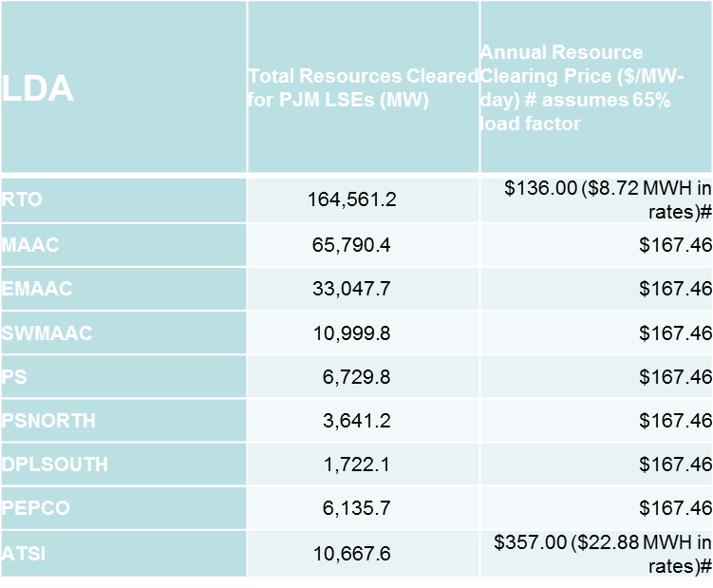
PJM Capacity Prices

Slide 17
Long-term Viability of RPM
New generation in congested areas
Liquidity Issues
Quickly address transmission needs

Slide 18
Long-term Viability of RPM
ATSI
Retirements (2,200 MW retired by First Energy, 1,500 MW retired by GenOn)
Remaining receive higher capacity prices
Separation of the zone from rest of RTO, CETL (import limit of 3,517
840 MW Eastlake unit does not clear, 1808 MW of demand resources clear
ATSI could have cleared as high as $537.33 MW-day
$357 MW-day clearing price, more than $100 higher than any prior clearing price, consumer rates will see $22.88 MWH

Slide 19
Long-term Viability of RPM
ATSI Consumers Pay
$450 million in new transmission
$357 MW-Day capacity to all generators ($500 million)
Consumers Get Reliability?
Reliability Must Run Contracts
Continued separation of the zone, higher prices

Slide 20
Long-term Viability of RPM
Problems with RPM
Transparency
Resource adequacy
Generator disincentive
Others

