Slide 1
Dynegy Energy Services
September 18, 2015

Slide 2
Today’s Topics
Dynegy Overview
Market Design
Renewable Portfolio Standards
PPA’s

Slide 3
Dynegy Corporate Overview
Dynegy generates reliable, environmentally responsible and affordable energy in the Midwest, Northeast and West Coast.
Dynegy’s 35 power stations can generate 26,000 megawatts of electricity.
Dynegy’s power stations provide our retail operations with advantages that our non-asset backed competitors don’t have.
Quick Facts
NYSE Ticker: DYN
Footprint: Located in 8 states
Generating Capacity: 26 GW
Power Plants: 35
Retail Customers: Over 850,000 residential and business customers
Annual Revenues: $5.5B
Employees: Approximately 2,700

Slide 4
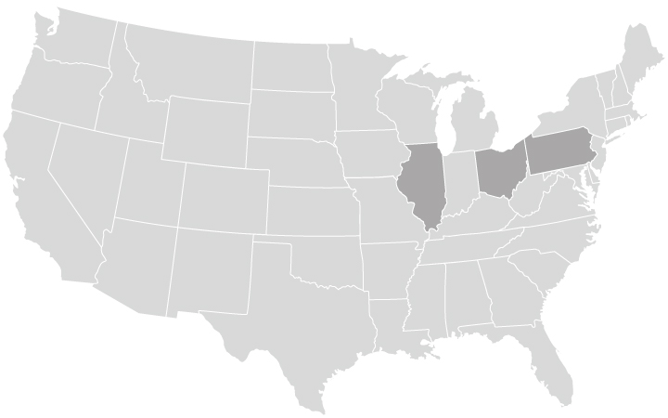
Expanding Geographic and Fuel Diversity
Operating Capacity by Fuel
Operating Capacity by Region
Dynegy Coal
Dynegy Gas
EquiPower Coal
EquiPower Gas
Duke Coal
Duke Gas
Dynegy Retail

Slide 5
Market Design
Favorable
Needs Improvement
Unfavorable or non-existent
Market Design “Heat Map”
 |  | PJM |  | ISO-NE |  | MISO |  | ERCOT |  | CAISO
DYN market footprint, in MW and as % of portfolio |  | ~11,000 MW, ~40% |  | ~4,000 MW, ~15% |  | ~7,000 MW, ~25% |  | N/A |  | ~2,700 MW, ~10%
High Scarcity Price Caps
Capacity Market
Forward Capacity Market
Sloped Demand Curve
Stable Market Rules
Performance Incentives |  | *
Both PJM and ISO-NE are leading the way with market designs that send appropriate price signals to address system stresses
*Planned but not approved

Slide 6
Renewable Portfolio Standards
Markets Preferred Over Mandates
Dynegy supports the integration of renewables and energy efficiency into the competitive wholesale and retail energy markets as long as there is a level playing field
Care needs to be taken by state policy makers when crafting mandates. Mandates should be:
State policy should assure a level playing field for all market participants, without providing a competitive advantage to some and distorting market signals that otherwise ensure stable, reliable and affordable power for Ohio customers of all classes.
Taking time to periodically assess existing RPS programs and to recalibrate them as necessary strikes us as a best practice.
Renewables and Energy Efficiency have a place in the nation’s energy mix, and mandates should be competitively neutral as possible

Slide 7
Monopoly Utility PPA Riders
Utility Propositions |  | Reality
PPAs are the only option for long term rate-payer stability |  | Dynegy offers various products and services including long-term contracts
PPAs ensure reliability of the power grid |  | PJM has a target reserve margin of 15%, with an actual reserve of 20% projected through the end of the decade
PPAs maintain Ohio’s energy independence |  | Participation in an ISO/RTO leverages the multi-state grid in the most cost-effective manner to serve local needs
New generation isn’t being built |  | New plants are under various stages of development in: Carrollton, Oregon, Middletown, Rolling Hills, Lordstown, and Avon Lake (conversion)
The PPAs offer value to consumers |  | Ohio consumers have already paid for the plants, including stranded asset payments
Plants will be retired prior to the end of their useful lives |  | Plants that are uneconomic and have already been paid for are at the end of their useful lives; joint-owned units can’t be unilaterally shut down
PPAs protect jobs and communities |  | The PPAs increase rates, putting Ohio at a competitive disadvantage
The utility proposals are a self-fulfilling prophecy – that is, if granted, no new generation will be built and reliability will be put at risk

Slide 8
For More Information on Dynegy
Ray Culver
Managing Director
Retail C&I Sales East
Dynegy Energy Services (East)
105 East 4th Street
Suite 100C
Cincinnati, OH 45202
T: 513. 287.2367
M: 502.445.9199
Raymond.Culver@dynegy.com
Don Schierenbeck
Senior Sales Executive
Retail C&I Sales East
Dynegy Energy Services (East)
105 East 4th Street
Suite 100C
Cincinnati, OH 45202
T: 513. 287.2150
M: 513.519.2844
Don.schierenbeck@dynegy.com
Todd Frank
Senior Sales Executive
Retail C&I Sales East
Dynegy Energy Services (East)
105 East 4th Street
Suite 100C
Cincinnati, OH 45202
T: 513. 287.2129
M: 513.225-1602
Todd.frank@dynegy.com
Katie Kiefer
Senior Sales Executive
Retail C&I Sales East
Dynegy Energy Services (East)
105 East 4th Street
Suite 100C
Cincinnati, OH 45202
T: 513. 287.7284
M: 513.519.9128
Katie.kiefer@dynegy.com

